Slide 1
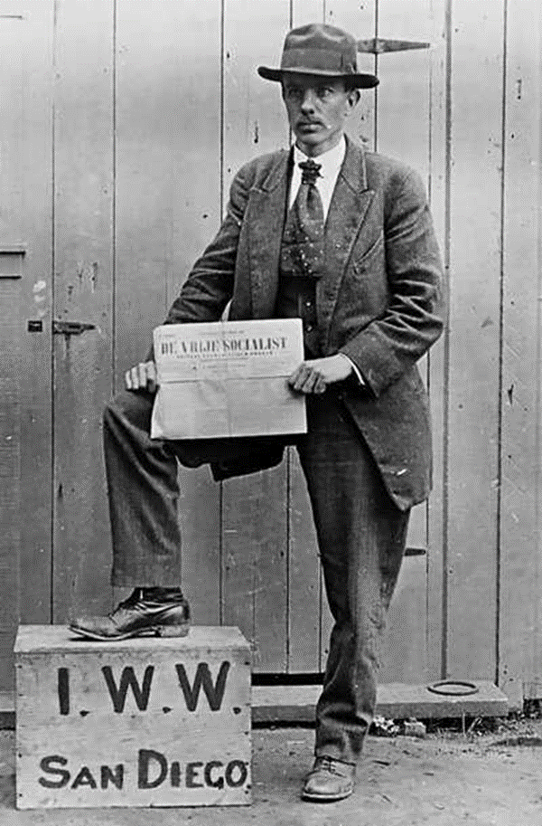
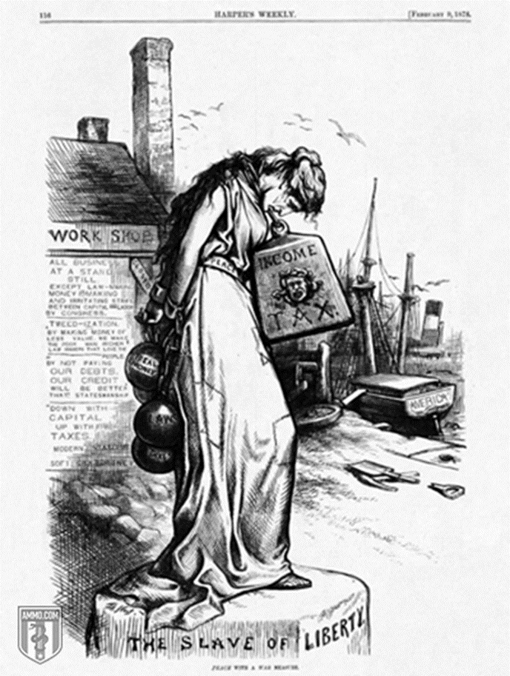
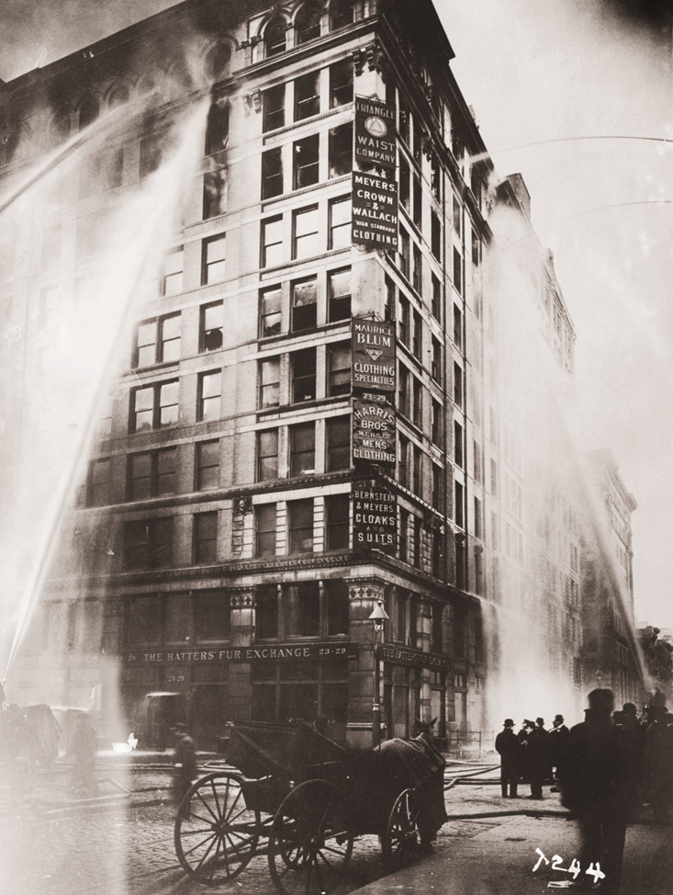
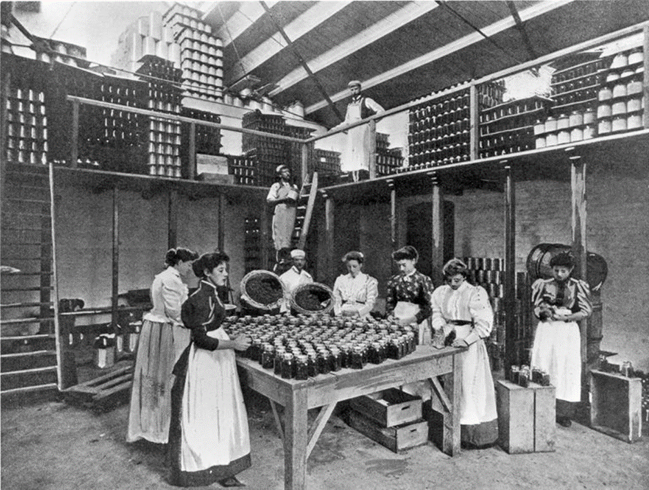
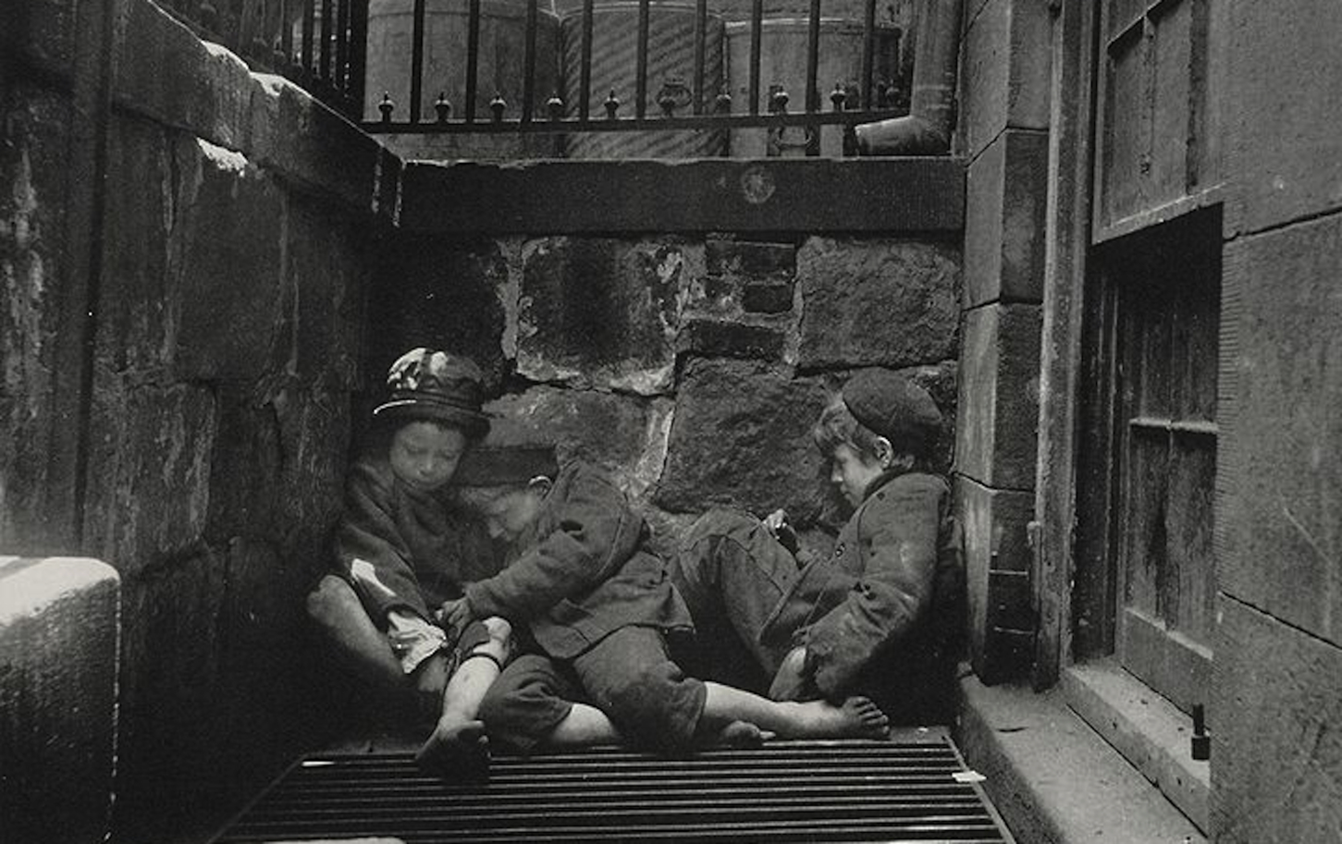
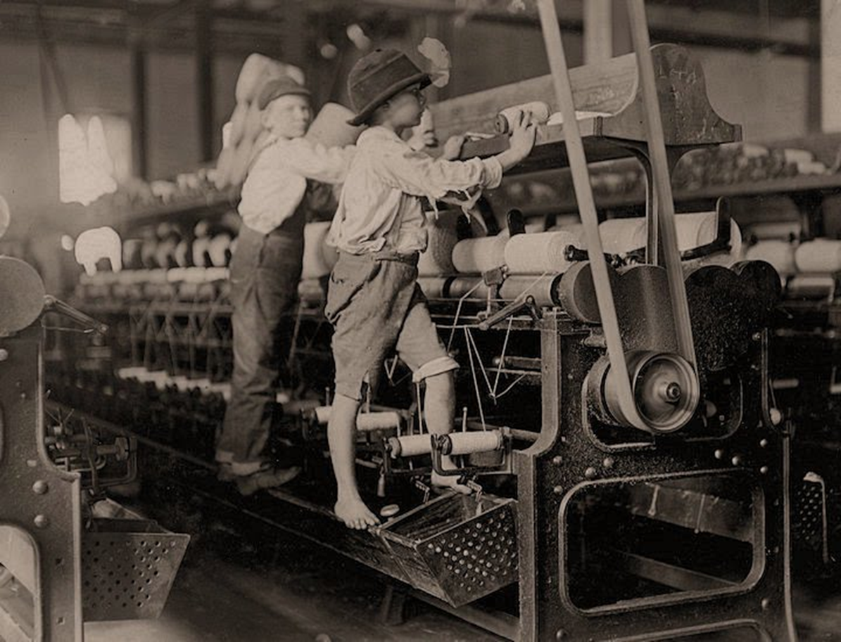
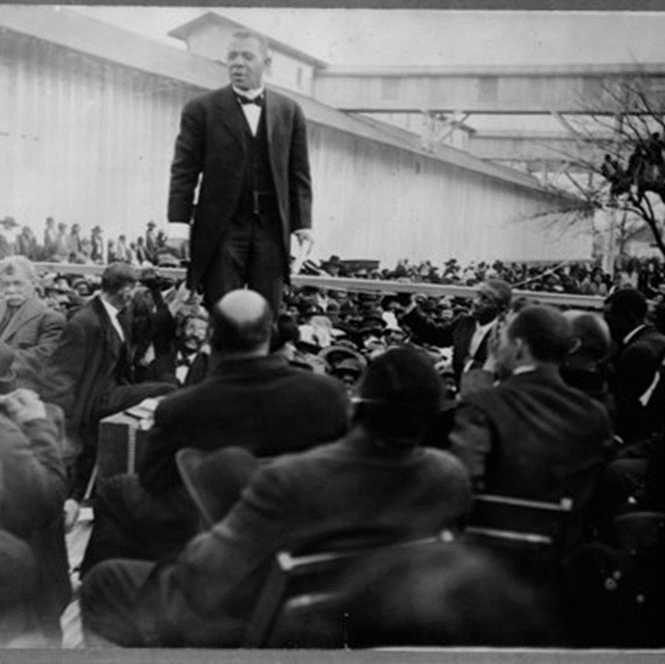
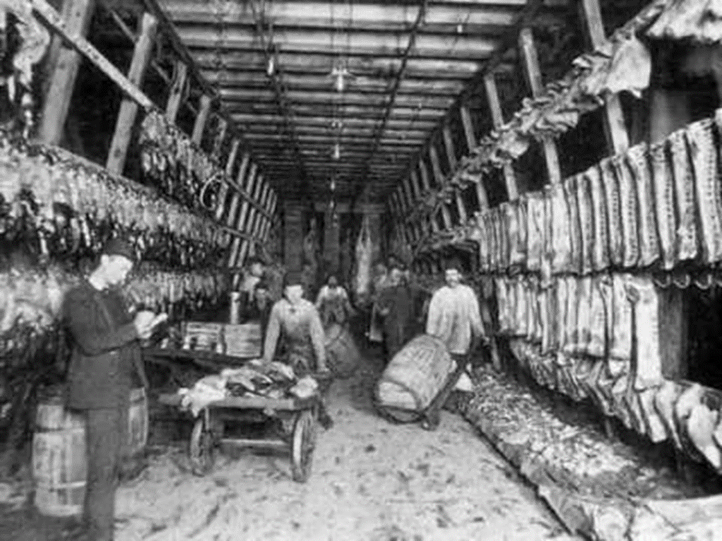
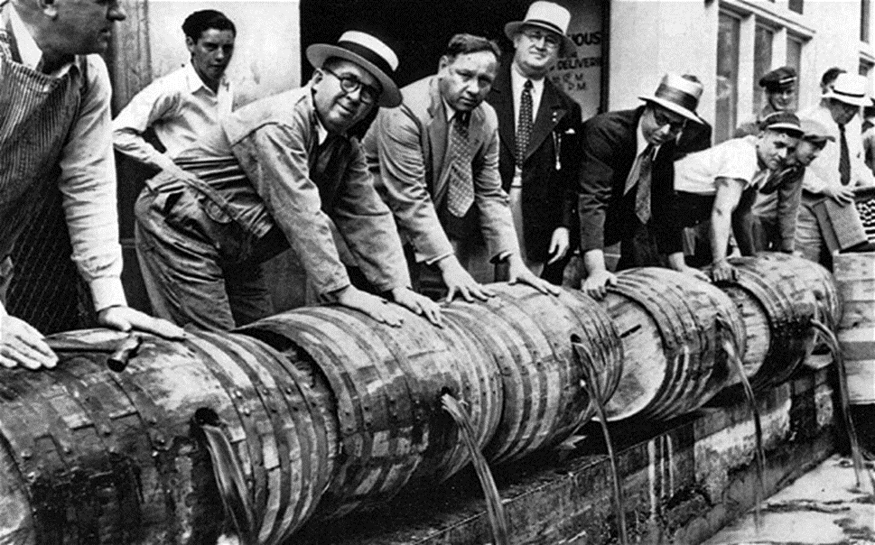
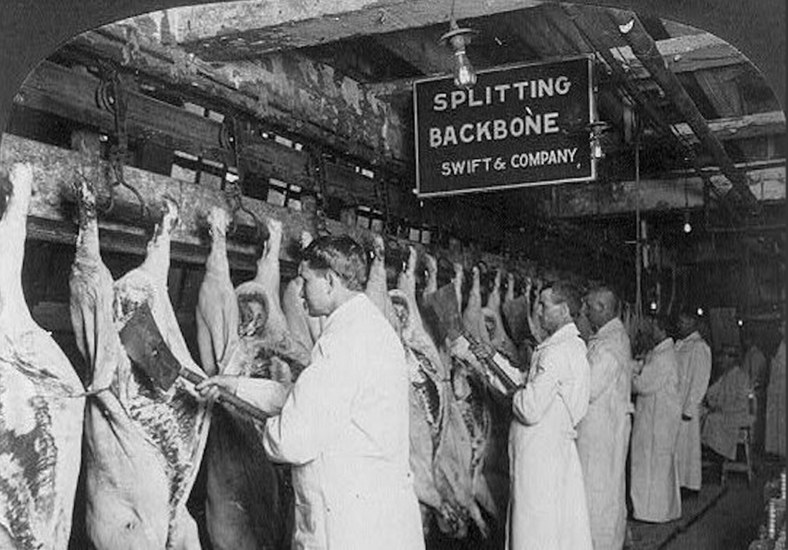
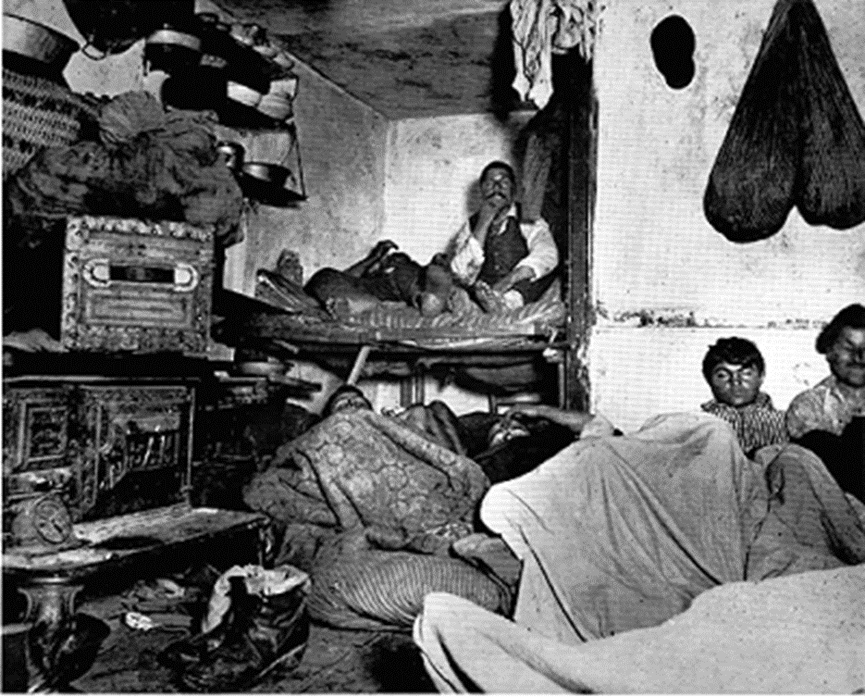
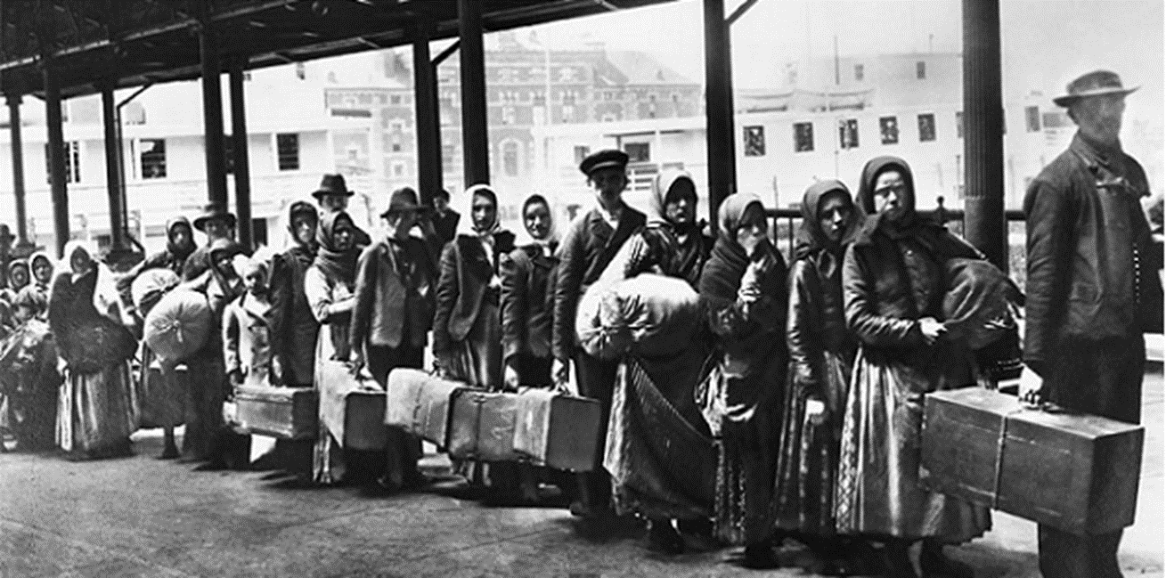
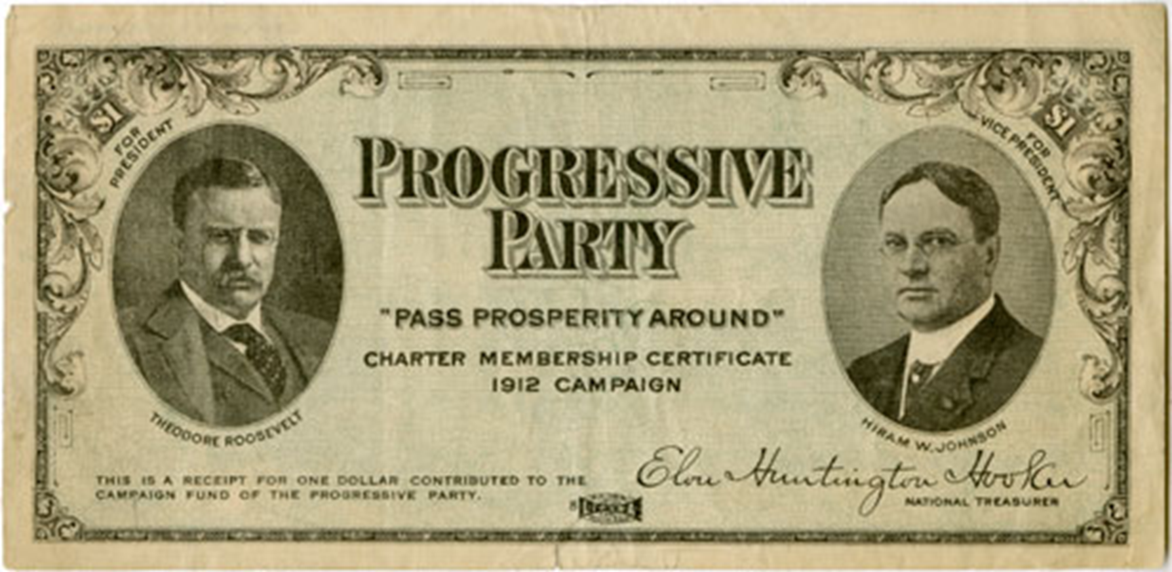
This is a political cartoon published after the passing of the 16th amendment which established federal income tax.
Members of the National Women's Party, petitioning in front of the White House in the early 1900s to advocate for Women's Suffrage.
The 1911 factory fire. Victims who were stuck in the building and couldn’t get out of the building due to lack of proper fire safety jumped to their death or were burned alive.
A member of the Industrial Workers of the World carrying out a free speech petition.
In the streets of New York, young children sleeping in alleyways. Children often got sick, and parents abandoned them during the day.
Two children working in a factory. Child Labor in factories was extremely normal for companies because it did not require the companies to pay as much.
Booker T. Washington making a speech about the Civil Rights Movement in Alabama.
In 1918 many of the men went to war to fight. This meant that women had to take over many of the mens responsiblilties while they were gone.
The passing of the 18th amendment prohibited the consumption of alcohol. They had to get rid of all alcohol.
Upton Sinclair's The Jungle revealed a lot of unknown things about the meatpacking industry.
Working conditions were abonibal. Many men working in slaughterhouses suffered from countrless injures from the horrific conditions they were forced to work in.
During this period many immrgrants came to America for a better life. However they were met with harsh living and working conditions.
For many immigrants and locals they would be packed in small houses. Many didn’t have clean clothes and lived in their own filth.
Theodore Roosevelts' political party that he established in 1912 after he lost his ticket on the Republican Party.

